Slide 1
Lab 1 Update
2.22.21
Kylie Outlaw & Maria Abbasi

Slide 2
Loop Timing
Task #4 Implementation
TIM2 on PA0
Count-up timer
Period of 100,000
Pre-scalar of 83
Every clock tick is 1 microsecond
Struct objects used to keep track of different loops’ timing
Total elapsed time stored using a uint32_t
Number of loops tracked using a uint16_t counter
Averages based on 65,535 consecutive loop timings for inner/outer loops
Averages based on 30 consecutive loop timings for the blink loop

Slide 3
Loop Timing
Task #4 Implementation
New “Loop_timer.h” and “Loop_timer.c” files
Holds data and functions for the “loop_timer” struct
Init, begin, stop, reset, print functions
Start tick
End tick
Total time
Number of loops completed
Each loop is measured using a uint16_t counter
Averages based on 65,535 consecutive loop timings

Slide 4
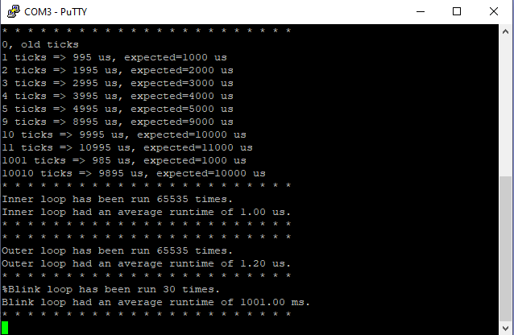
Loop Timing
- Adjusted the main.c calibration to test TIM2 ticks.
- Looking at the output, 1000 clock ticks match 1 HAL tick .
- HAL tick is set up by the system so that each tick is 1ms, or 1/1000 of the processor clock speed.
- The inner loop and outer loops are timed automatically in the code and the average runtimes are output to COM3.
- The inner loop runs at 1.0us average.
- The outer loop runs at 1.2us average.
- The blink loop runs at 1001.00ms, or 1.001s on average.
- This is slightly higher than expected.
Image: COM3 output

Slide 5
Scheduler Priority

Slide 6
Current Schedule Priority
Sch_basic.c -> sch_loop()
Polled tasks – checks tasks in loop for hardware interrupt conditions
First scheduled, first executed
ADC ➡ UART Rx ➡UART Tx

Slide 7
Current Schedule Priority
Tasks_lab_1.c -> timer_cb_text#()
Timeout tasks
Based on tick timeout, software-enabled interrupt
Higher priority than polling loop
Every ~1s LED toggles

Slide 8
Scheduling Approach
Asynchronous events handled by hardware interrupts
Synchronous events / periodic tasks handled by software interrupts
Earliest Deadline First
Scheduling approach you plan to implement
Data structures needed for implementations
What info needed about the application, tasks (e.g. deadline??)
Identify context you are considering – specific application – to help select numbers (periods, deadlines, etc.), make design decisions
Describe how you intend to use peripherals and interrupts

Slide 9
Scheduling Approach
Asynchronous events handled by hardware interrupts
Synchronous events / periodic tasks handled by software interrupts
Earliest deadline first
Submit a presentation that:
Summarize timing results (e.g. table, plot)
Scheduling approach you plan to implement
Data structures needed for implementations
What info needed about the application, tasks (e.g. deadline??)
Identify context you are considering – specific application – to help select numbers (periods, deadlines, etc.), make design decisions
Describe how you intend to use peripherals and interrupts

Slide 10
YOU CAN ALSO SPLIT YOUR CONTENT
White
Is the color of milk and fresh snow, the color produced by the combination of all the colors of the visible spectrum.
Black
Is the color of ebony and of outer space. It has been the symbolic color of elegance, solemnity and authority.

Slide 11
IN TWO OR THREE COLUMNS
Yellow
Is the color of gold, butter and ripe lemons. In the spectrum of visible light, yellow is found between green and orange.
Blue
Is the colour of the clear sky and the deep sea. It is located between violet and green on the optical spectrum.
Red
Is the color of blood, and because of this it has historically been associated with sacrifice, danger and courage.

Slide 12
EXTRA GRAPHICS

Slide 13
SlidesCarnival icons are editable shapes.
This means that you can:
Resize them without losing quality.
Change line color, width and style.
Isn’t that nice? :)
Examples:

Slide 14
Diagrams and infographics

Slide 15
😉
Now you can use any emoji as an icon!
And of course it resizes without losing quality and you can change the color.
How? Follow Google instructions https://twitter.com/googledocs/status/730087240156643328
✋👆👉👍👤👦👧👨👩👪💃🏃💑❤😂😉😋😒😭👶😸🐟🍒🍔💣📌📖🔨🎃🎈🎨🏈🏰🌏🔌🔑 and many more...

